Slide 1
Object Detection
of three class
施彥頡Jay D1171462
楊駿騏Jacky D1166905

Slide 2
Motivation
I believe that everyone who grew up under the Taiwanese education system has the same experience. In the past, the first three questions in the Chinese language test were given to four characters that seem to have similar pronunciation, and then you have to choose a different one. I think this is The most difficult and unnecessary questions in the Chinese language exam, so I want to write a program to solve these questions

Slide 3
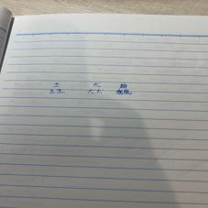
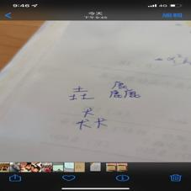
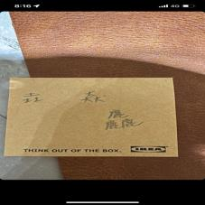
Proposed method
Initially, the quality of our database was poor after resizing, and some images were on paper with grids or stripes, or the color of the text was too similar to the color of the paper. These issues made it difficult for the program to recognize the characters. After removing these problematic photos and adding more high-quality and clearly visible data (without resizing), the accuracy improved to around 80% to 85%. We then started examining the misclassified test data and conditionally adding more training data (for example, adding more "垚" data if it had more errors). This approach led to a significant improvement in accuracy, which stabilized between 97% and 100%.

Slide 4
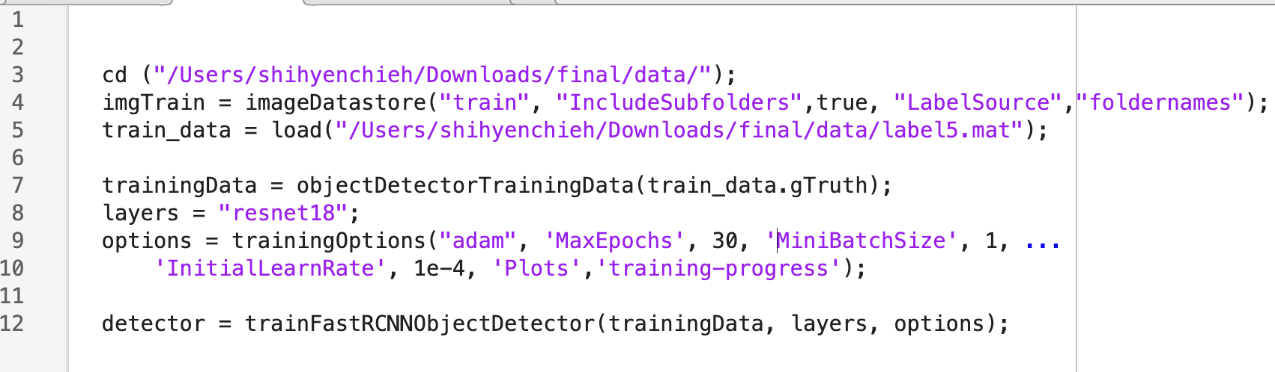
Code (Train)

Slide 5
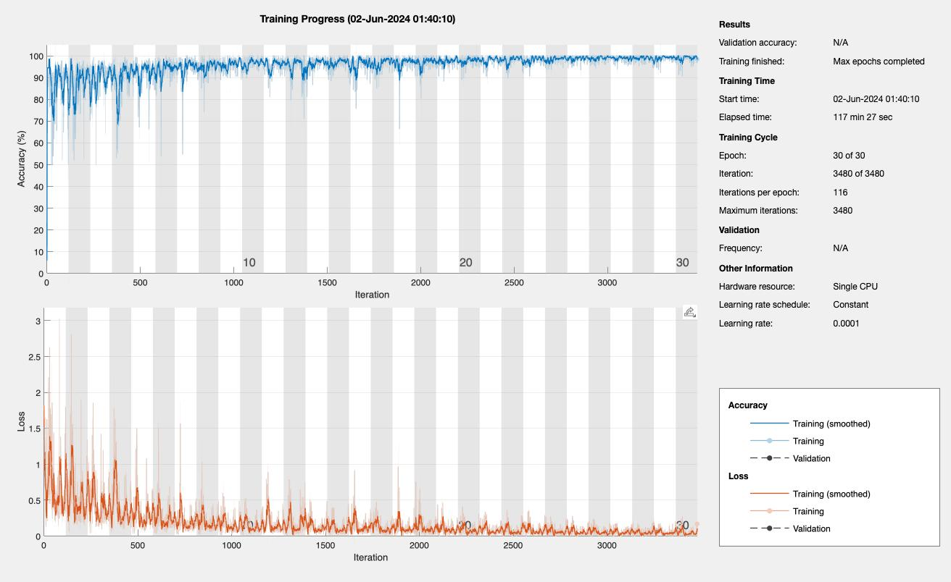
Result

Slide 6
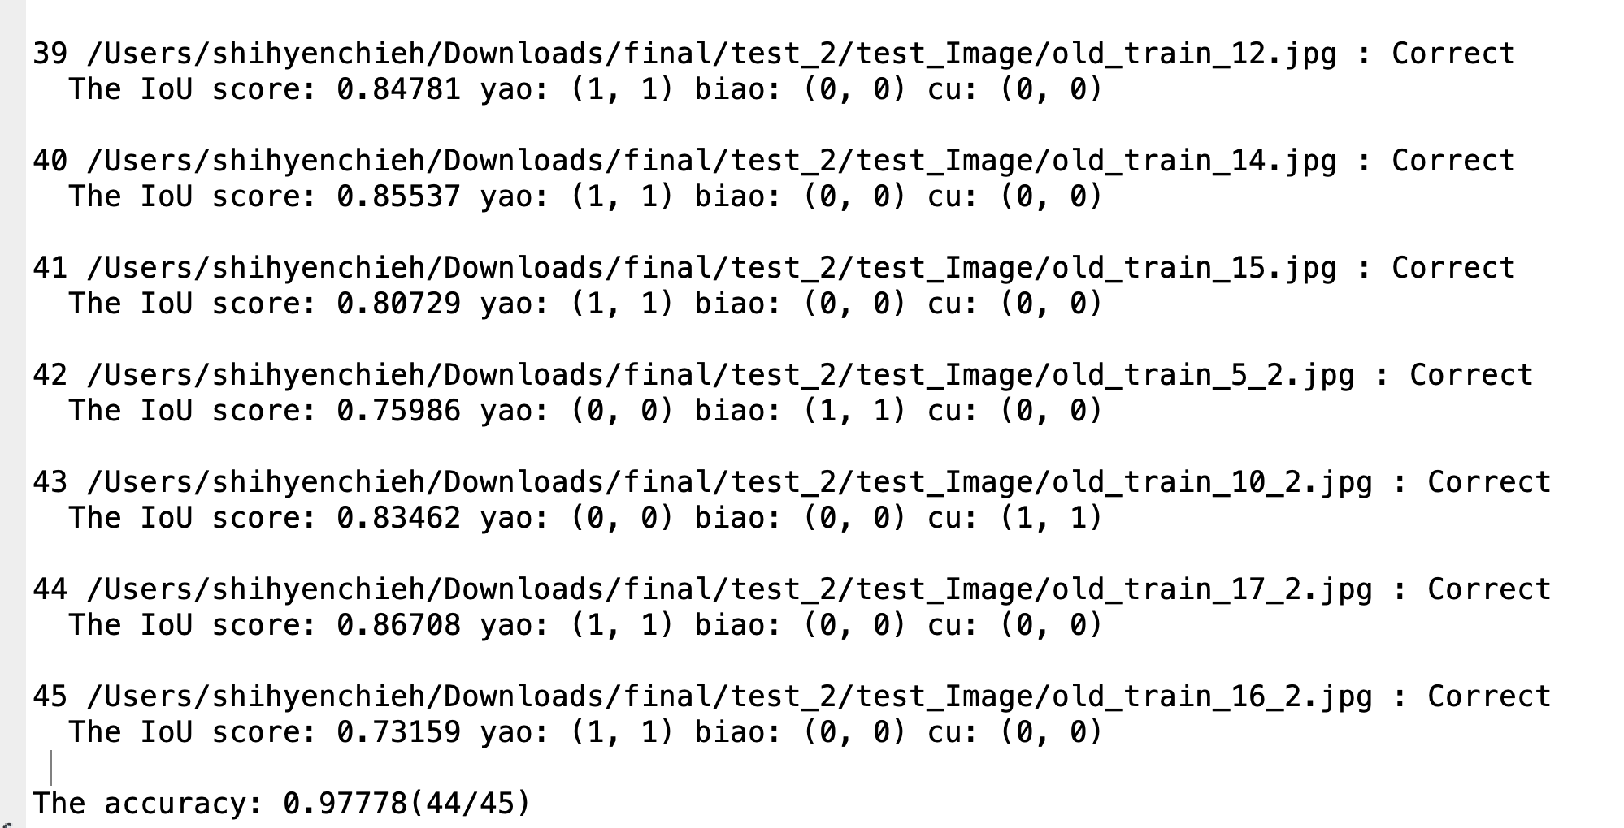
Accuracy
Notes:
There are two criteria to check whether the prediction results are correct
1. IoU score must be greater than 0.5
2. The number of words must be exactly the same as the read word count

Slide 7
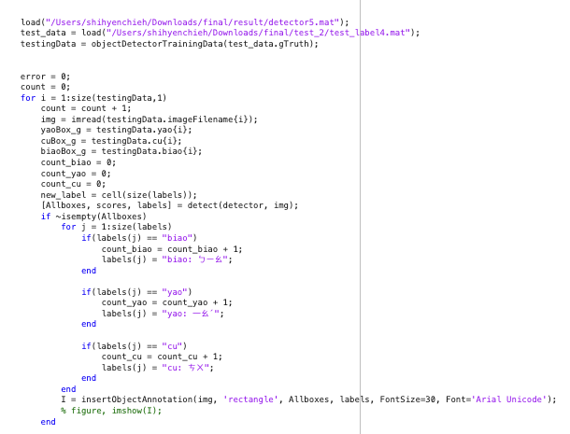
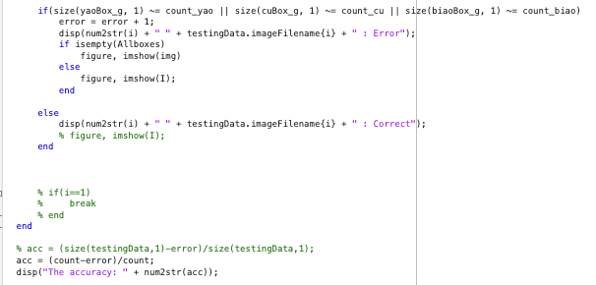
Code(Accuracy)

Slide 8
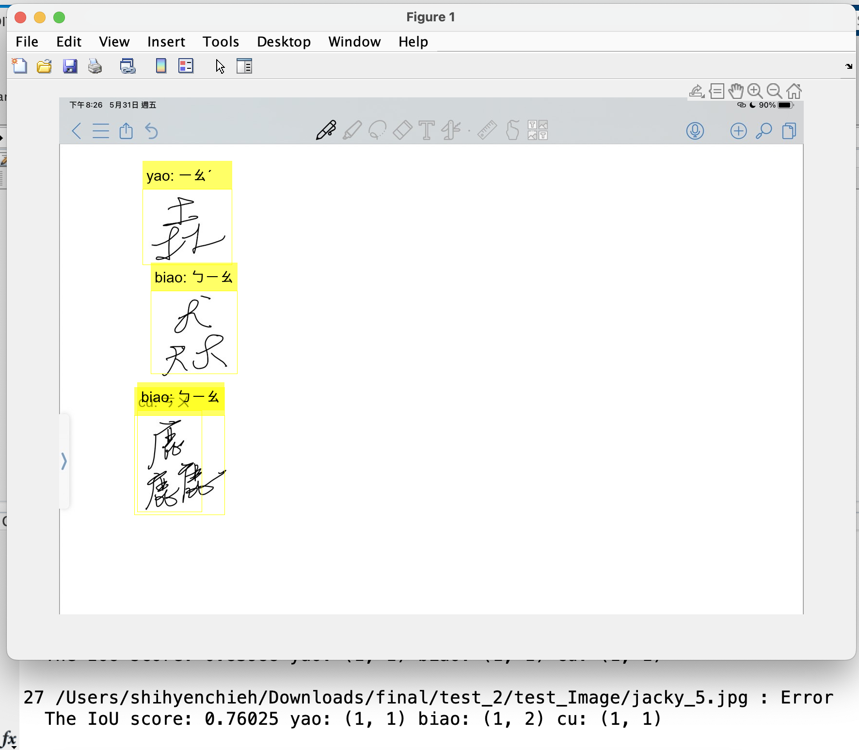
Error Image

Slide 9
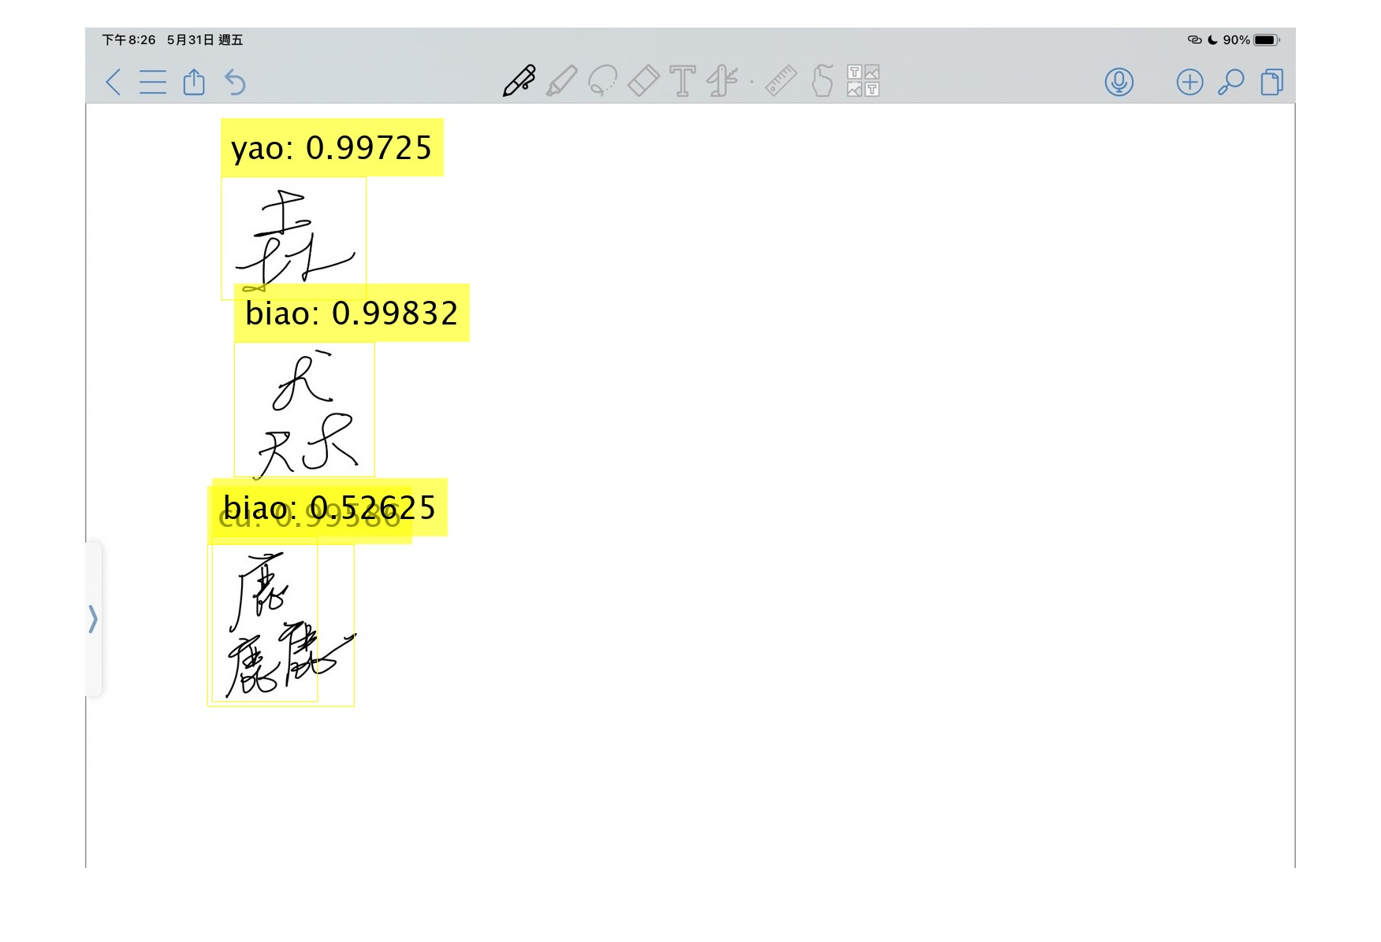
Solution
To compare the blocks, if there are two blocks are too close, then only keep the higher predicted score one
The predicted correct block score is higher than 95%. So we can delete the block if the score is lower than 0.75

Slide 10
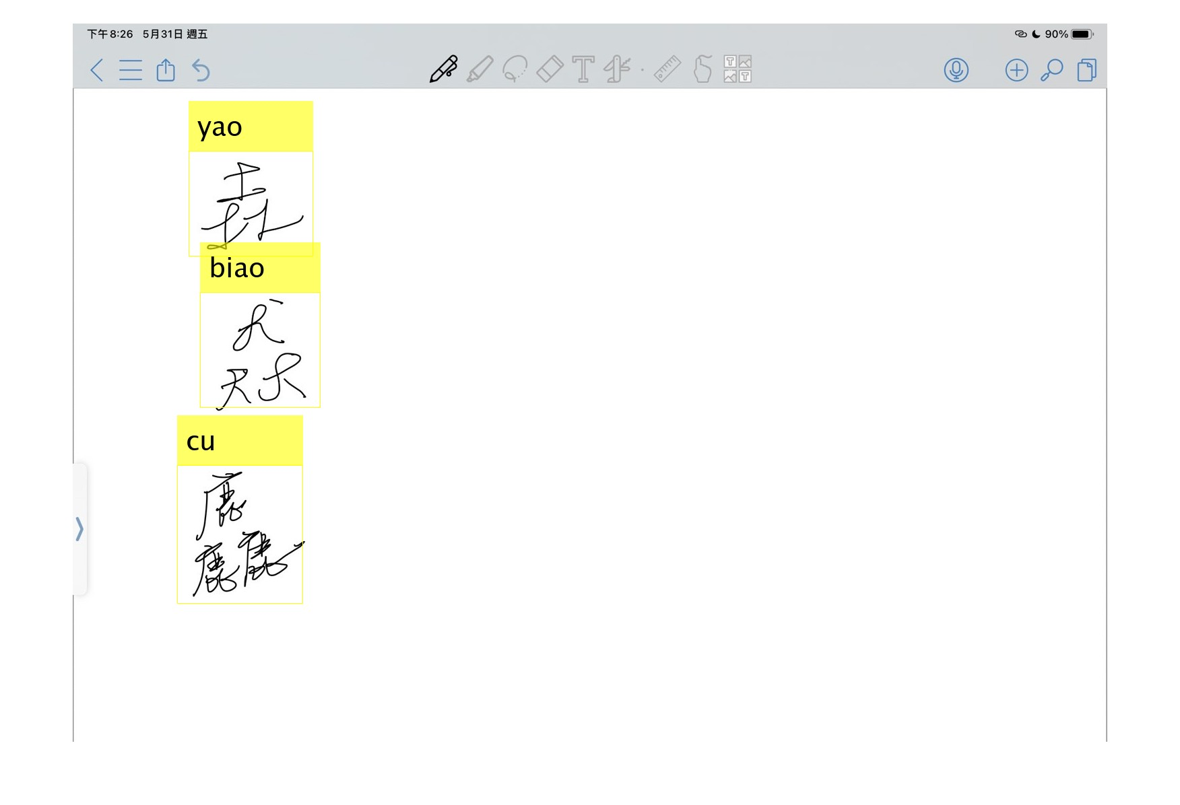
Result

Slide 11
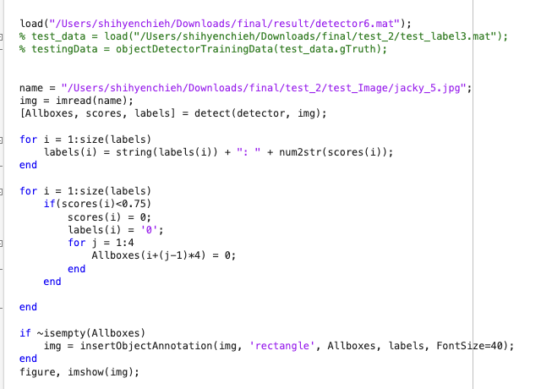
Code (delete the block)

Slide 12
Demostration

Slide 13
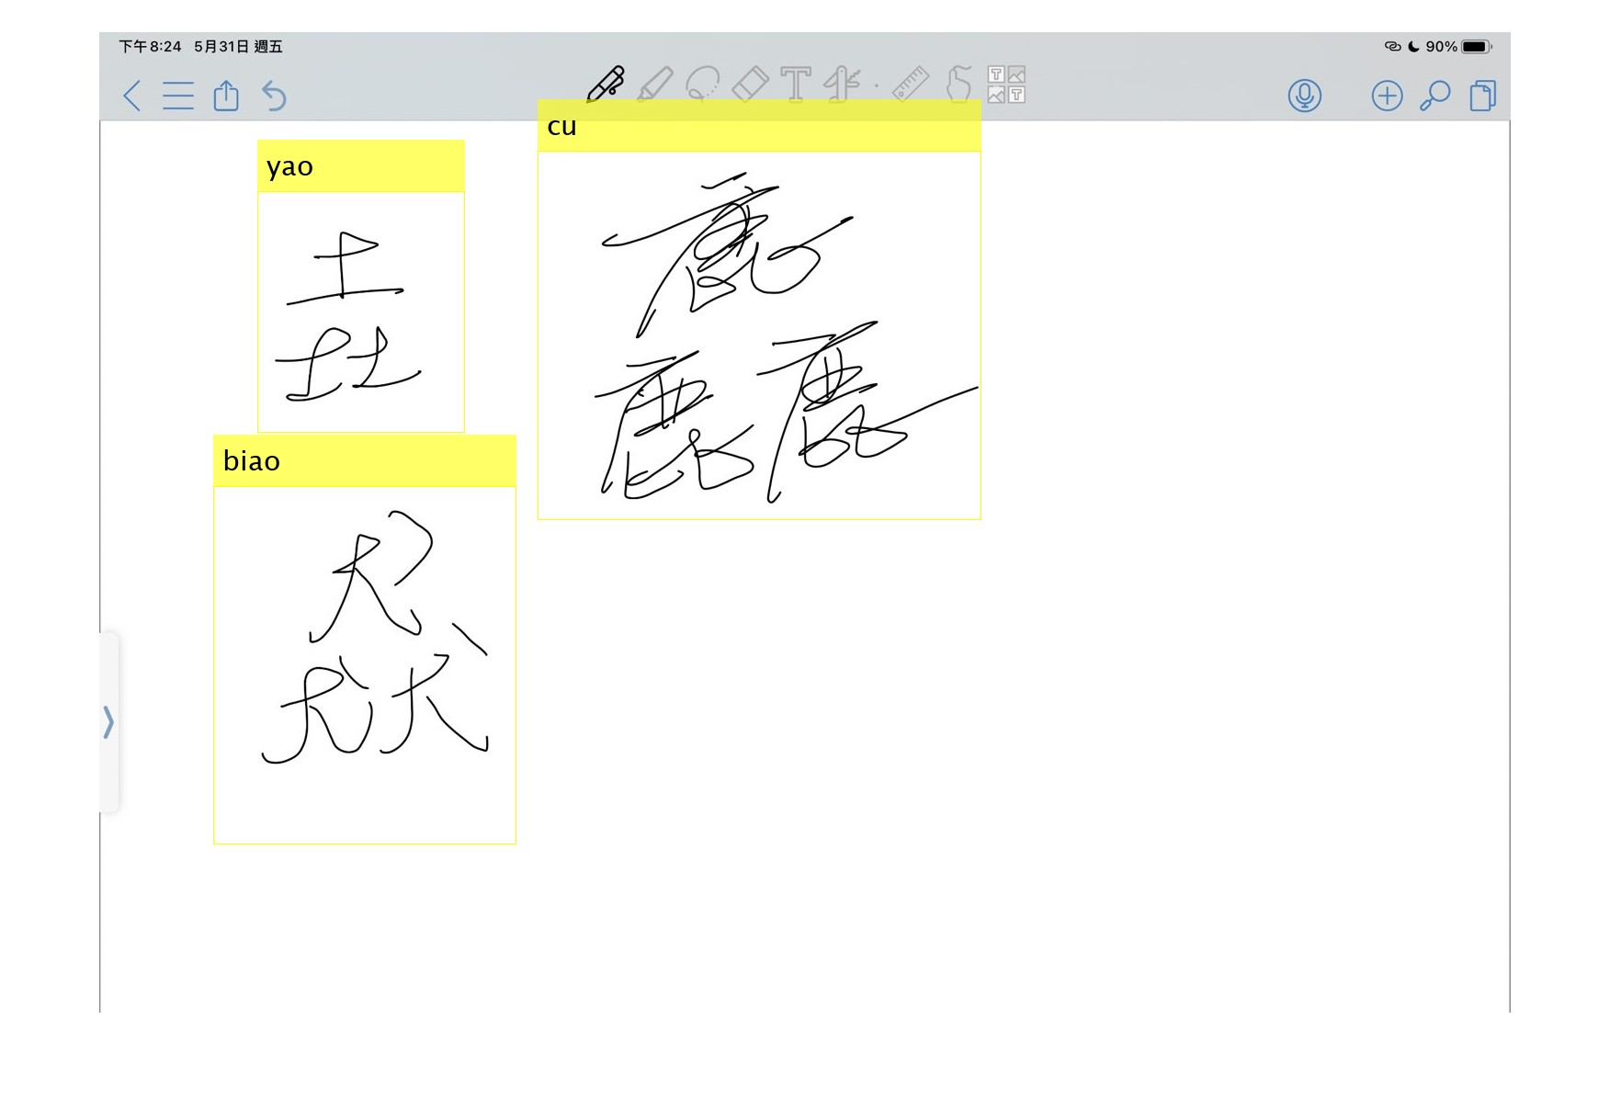
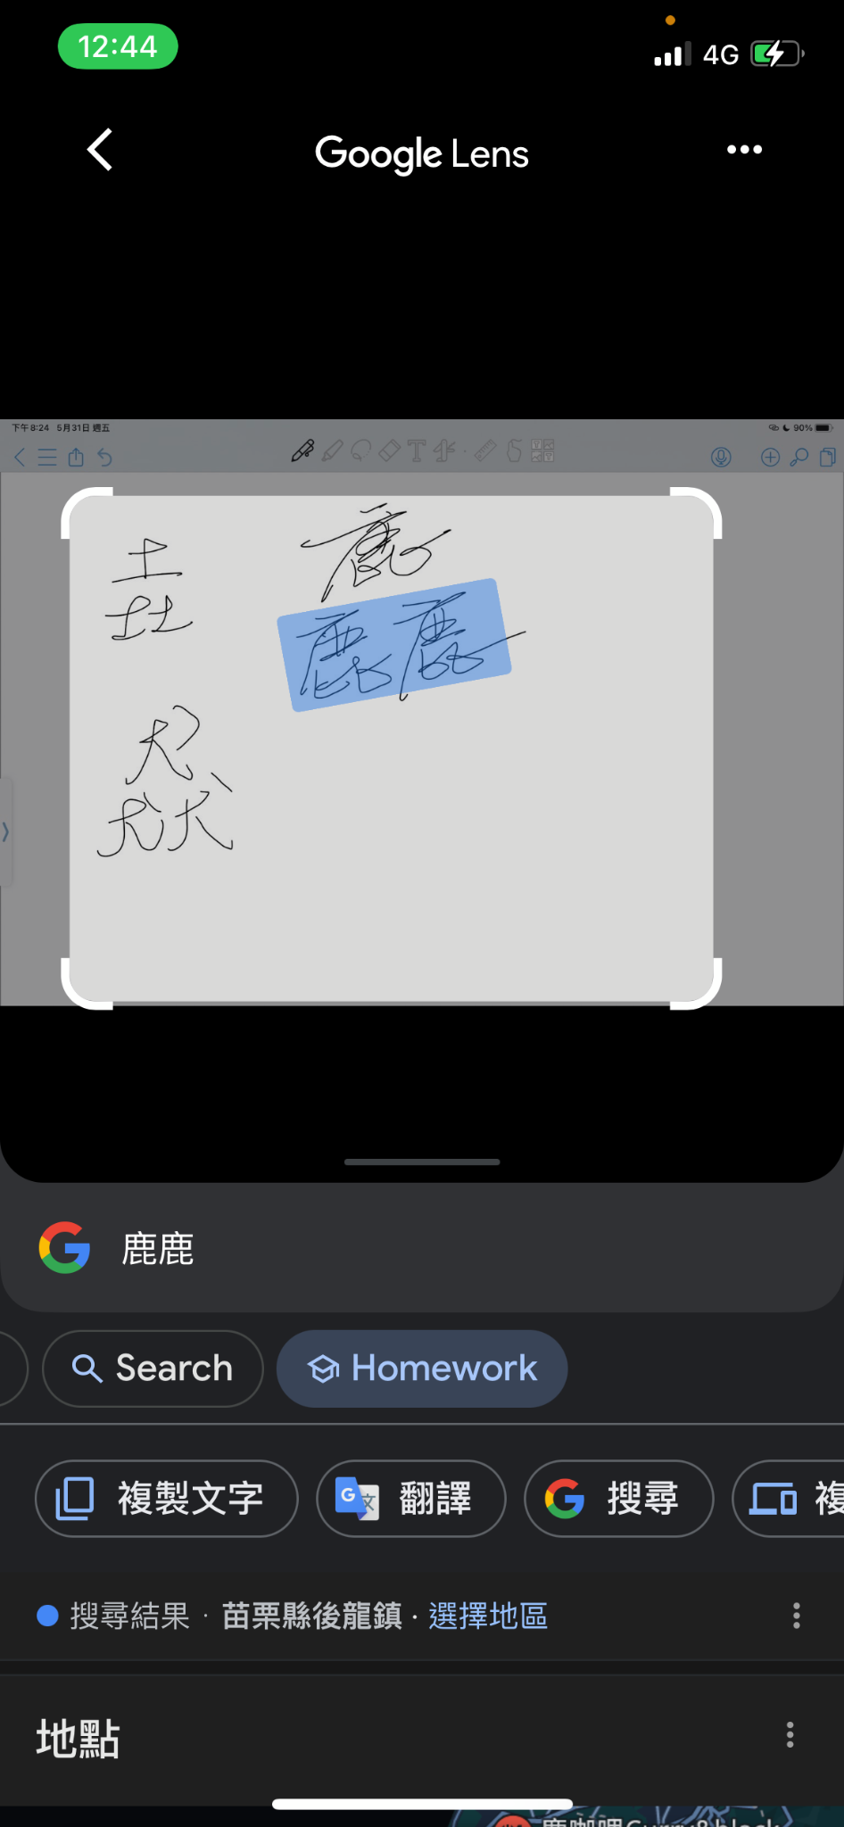
Comparison with google

Slide 14
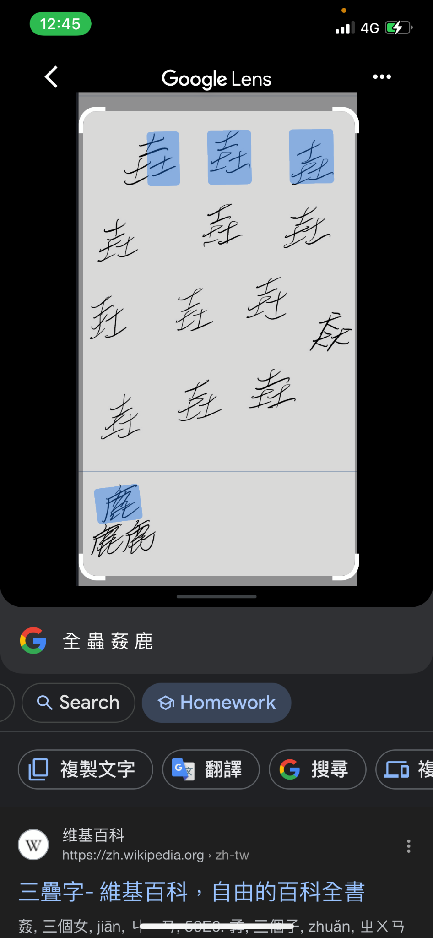
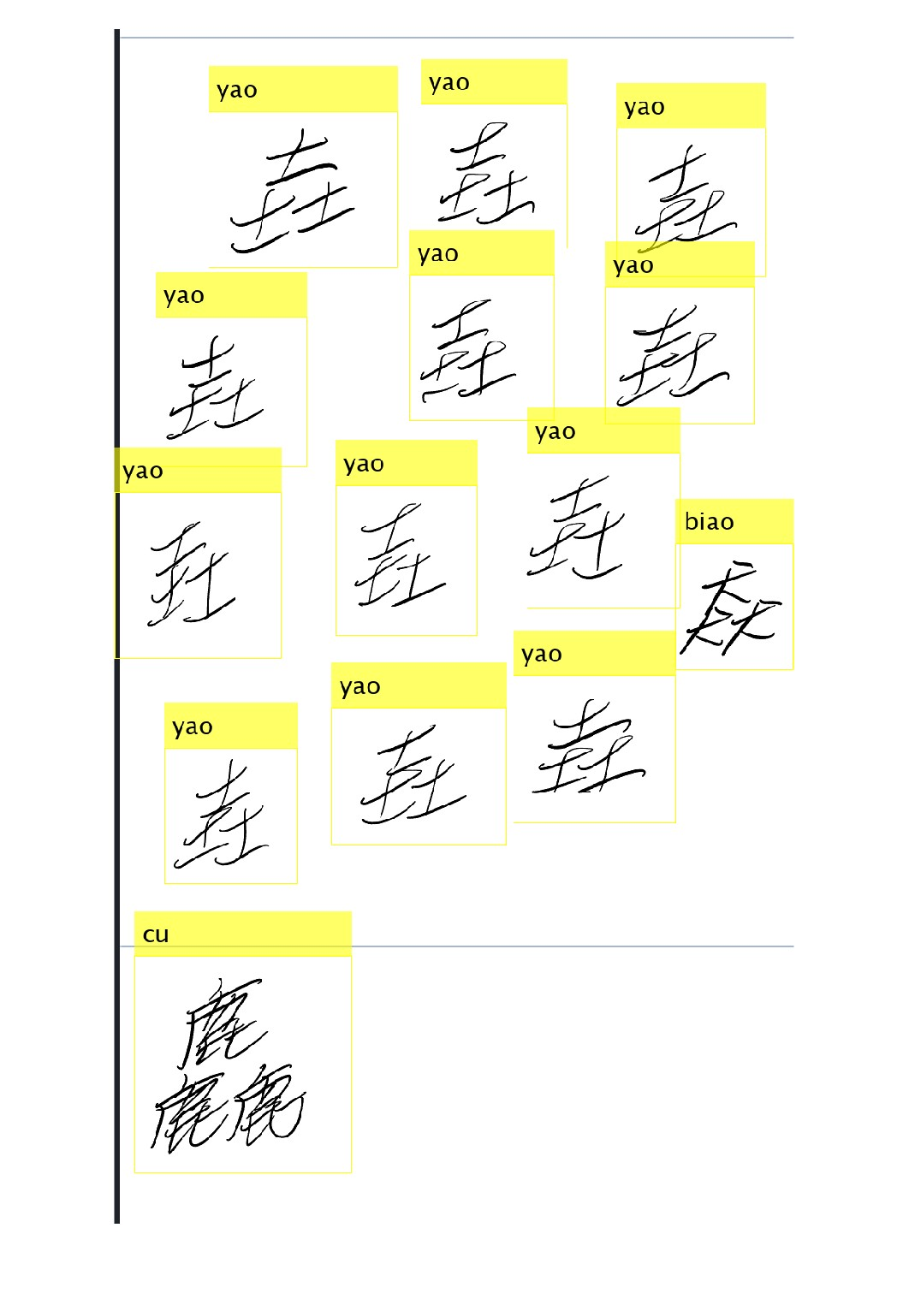
Comparison with google

Slide 15
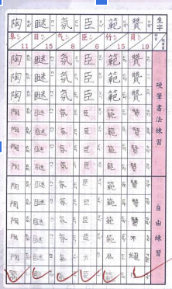
Conclusion
1. Educational purposes:
The technology for identifying Traditional Chinese characters can be used in the field of education to help students better learn the Mandarin Phonetic Symbols (MPS) of the characters and understand Traditional Chinese and improve learning efficiency. And it can also help teachers judge students’ homework books.
2. Intercultural Communication:
For non-native Chinese speakers, understanding Traditional Chinese may be
difficult. This program can help them better understand and learn Traditional
Chinese and promote cross-cultural communication.

Slide 16
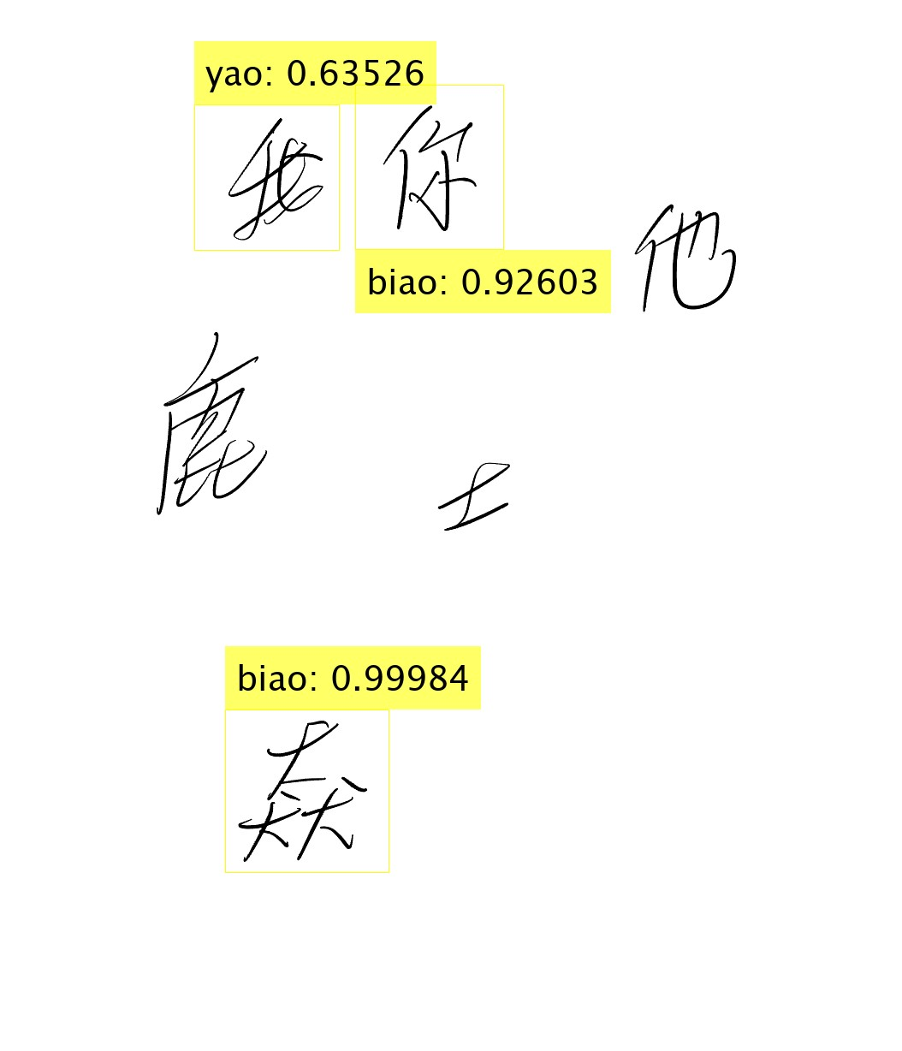
Future work
This program may misjudge when testing untrained Chinese characters, as shown in the picture below, but we can add more Chinese characters to the training data set to achieve the goals written in our conclusion. and solve this problem. But this is the only way we can think of right now.

